Slide 1



TEAM CODELANDERS
THE BIG IDEA
RADICAL EMPATHY.

Slide 2



ABOUT US
At The Big Idea, the broken model of workplace training is being redefined. For too long, unconscious bias and microaggressions have gone unaddressed.
Through our AI-driven immersive platform, realistic workplace scenarios are simulated. Continuous feedback is provided and an accountability score is maintained so that real progress can be ensured. Human oversight is guaranteed by a unique self-complaint mechanism, allowing workplace culture to be strengthened through constant learning.
It is our mission for awareness to be moved into action, so that workplaces are built where fairness is treated as a reflex, not an afterthought.
02

Slide 3


Problem
Statement
Workplace discrimination, unconscious bias, and microaggressions are often subtle, making them difficult to detect and address. Employees and employers may have awareness or empathy gaps, and conventional training methods frequently fail to create lasting behavior change or deep emotional understanding. There is a need for immersive learning solutions that simulate real-world workplace dynamics, foster empathy, and cultivate inclusive organizational cultures.
03

Slide 4
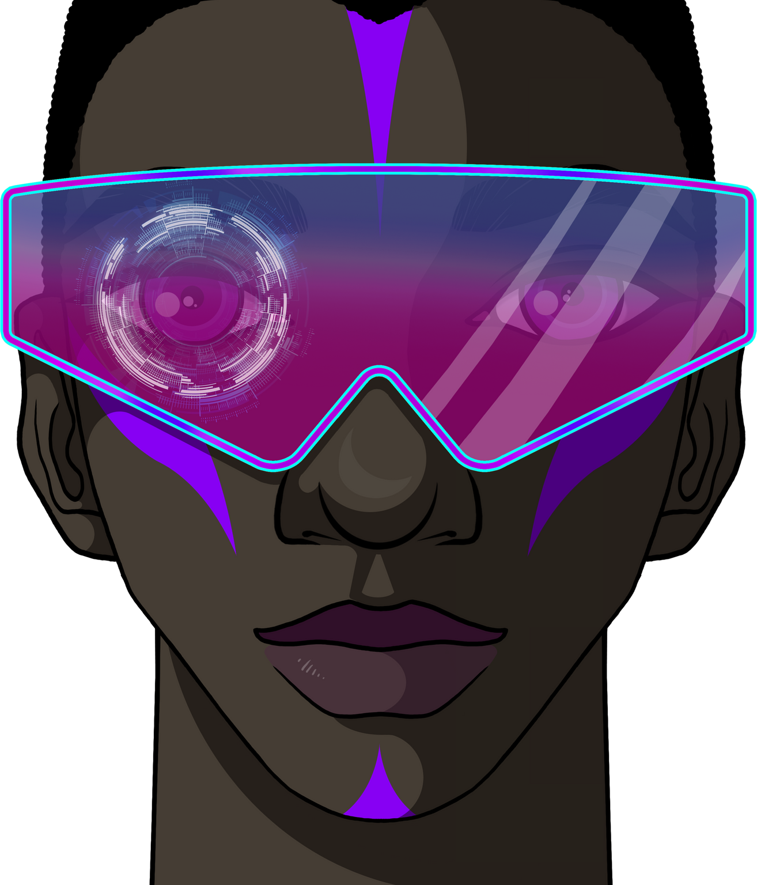
INTRODUCTION
Conventional training methods are considered ineffective, as long-term behavioral change is rarely achieved.
An AI-driven immersive solution has been proposed so that real-world scenarios can be simulated and awareness can be increased.
A potential situation is analyzed and proper feedback statements are generated to guide improvement.
A track record score is maintained for employees and employers so that accountability is ensured.
04

Slide 5
INTRODUCTION
A mood analyser is implemented to identify facial expressions and provide clear feedback on emotional patterns.
A self-complaint mechanism is integrated, enabling concerns to be raised when an incident is not recognized by AI.
Real-time events are captured and assessed, allowing workplace culture to be strengthened through continuous learning.
04

Slide 6






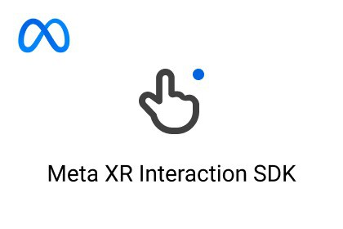
TECH STACK
05

Slide 7
06
FLOWCHART
THE BIG IDEA
SERVICES
PRODUCTS
Real time simulation
Mood analyser
Self-help station
Query desk
Website
In-House Analyser
Situation analyser
Realtime training for bias
VR System regenration
Record maintanance

Slide 8


MOOD ANALYSER USING GOOGLE API
Our project uses a mood analysis tool that leverages Google’s Image processing API to detect emotions from visual input. By analyzing facial expressions, the system identifies whether the mood expressed is positive, negative, or neutral. The results are displayed in real time, providing users with clear feedback on emotional patterns. This tool can be applied in workplace settings to enhance self-awareness, communication, and emotional intelligence.
07

Slide 9
REALTIME SIMULATION USING META XR & UNITY
We built a real-time immersive simulation using the Meta XR platform and Unity, designed to help employees experience workplace bias and microaggressions from different perspectives. Instead of traditional training, our simulation places the user inside realistic workplace scenarios where they can interact, make decisions, and immediately see the impact of their choices.
Powered by Unity’s 3D environment and Meta XR’s immersive capabilities, the simulation creates lifelike experiences that foster empathy, self-reflection, and behavioral change. Users don’t just learn about bias — they feel it first-hand, making the training more impactful and memorable.
08

Slide 10

SELF-HELP AND QUERY DESK
We created a self-help and query desk system powered by NLP and machine learning models, with Pandas handling data processing and analytics. The platform allows employees to ask workplace-related questions in natural language, and the system provides instant, context-aware answers. It also analyzes past queries and feedback to continuously improve its responses and suggest relevant resources.
By combining NLP for intent detection, ML models for prediction and personalization, and Pandas for insights from employee data, the solution works like an intelligent virtual HR assistant—reducing response times, improving accessibility, and empowering employees with self-help tools.
09

Slide 11
IN-HOUSE ANALYSER
We developed an in-house analyzer and real-time training platform that uses VR/XR (Meta platform), Unity World Builder, and Generative AI to tackle workplace bias. The analyzer evaluates situations—such as microaggressions, bias, or unfair interactions—and generates tailored immersive training modules on the spot.
By blending regenerative AI for dynamic scenario creation, Unity for realistic environments, and Meta XR for full immersion, employees are not just told about bias—they are placed directly in evolving workplace situations where they must act, reflect, and adapt in real time. This creates personalized, experiential learning that builds deep empathy and drives lasting behavioral change.
10

Slide 12
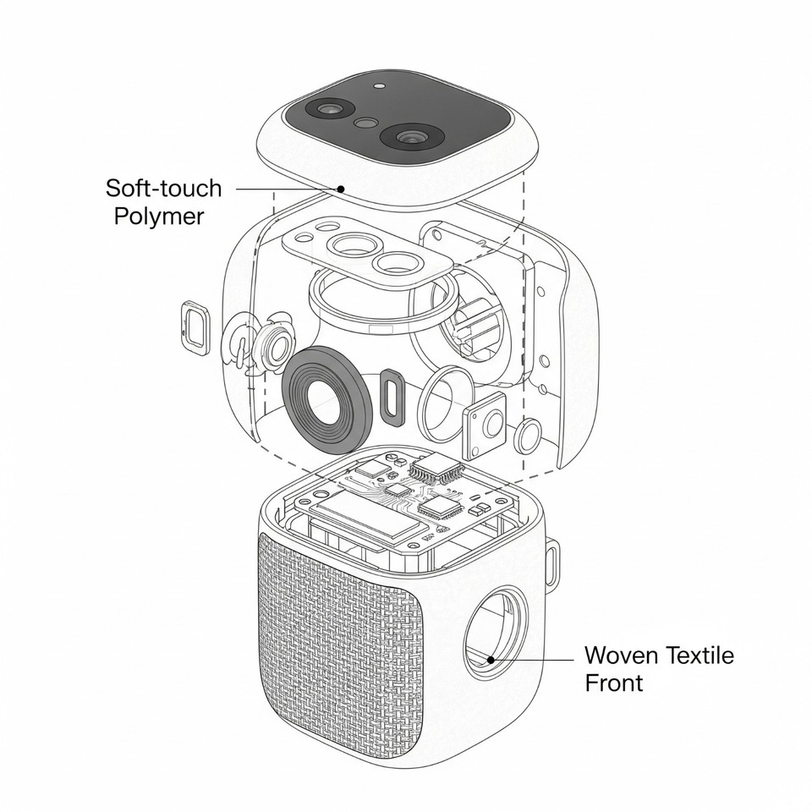
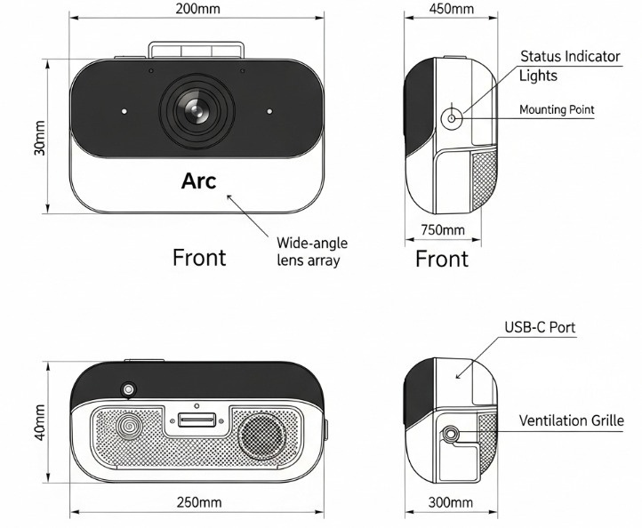
DESIGN CONCEPTS- FairSight

Slide 13
12
WEBSITE
Our team has desinged a website prototype using Figma that serves as the central hub for our immersive workplace bias training ecosystem. The site integrates features like VR system access and regeneration, record maintenance for tracking employee progress, and a mood analyzer that gauges user sentiment during training.
The platform acts as a one-stop interface—employees can enter VR simulations, managers can monitor records and improvements, and the mood analyzer provides insights into emotional responses, helping personalize the training journey. This ensures that bias awareness is not just trained, but also measured, tracked, and continuously improved through a sleek, intuitive web experience.

Slide 14

BUDGET ALLOCATION & PRODUCTION COST
In-house Mood Analyser (Soft-touch Polymer Casing)
Hardware (25%) – ₹12,000
Microcontroller, sensors, display, connectivity
Casing (15%) – ₹8,000
Soft-touch polymer casing, internal housing
Software/API (45%) – ₹22,000
Google NLP API, in-house development & testing
Miscellaneous (15%) – ₹6,000
Testing, power, packaging
➡ Estimated Total (Prototype): ₹48,000 – ₹50,000
13

Slide 15
Meet The
Code Landers
CHITTESH D- 25BRS1255
ANAMITHRA GOVINDARAGAN- 25BRS1291
RAMYASHRI S- 25BRS1144
MOHAMED FAHEEM- 25BRS1326
S NAVYASHRE- 25BRS1398

